Slide 1
PwC Digital Assurance – Audit Presentation
ShieldGroupe Audit Review
Insights from Data Analytics & ERP Authorization Audit

Slide 2
Executive Summary
Claims analysis identified unusual payment patterns.
Multiple claims processed with identical payment value (~4999 CHF).
IT authorization review revealed one role assignment exception.
Overall system controls largely effective with minor issues.
Recommendations provided to strengthen control environment.

Slide 3
Data Analytics Insights
Claim activity increased significantly between 2016–2018.
2018 recorded the highest number of claims.
Claim value for Sword AG consistently ~4999 CHF.
Pattern suggests possible threshold-based approval control.
Monitoring of repetitive claim values recommended.

Slide 4
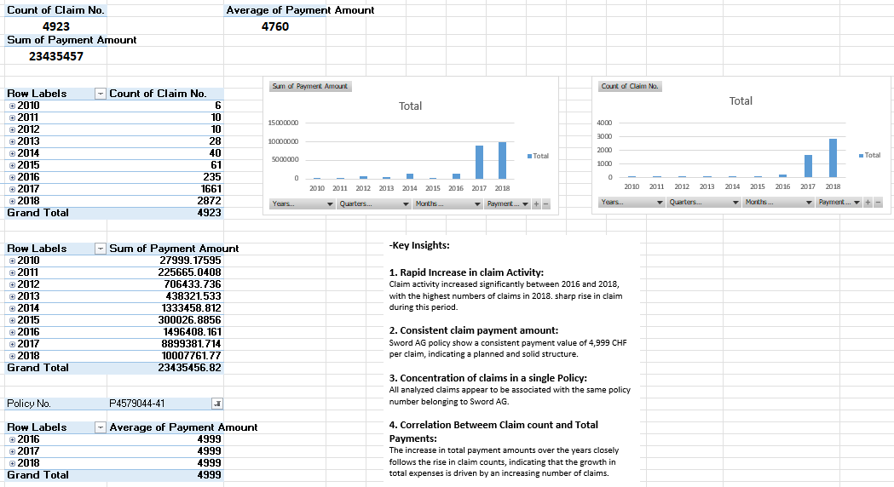
Findings of the dash boards

Slide 5
IT Authorization Audit Findings
Audit Scope:
Joiners (new user access)
Movers (role changes)
Leavers (access removal)
Password configuration
Key Finding:
One incorrect role assignment identified and corrected.

Slide 6
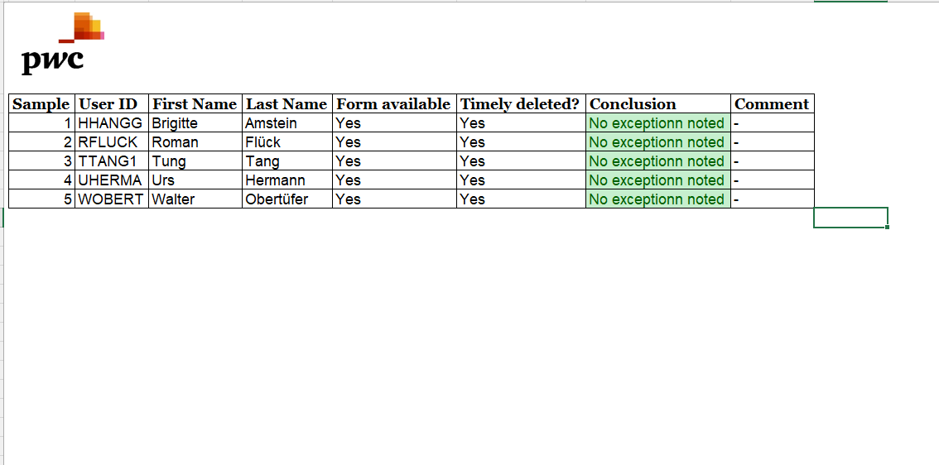
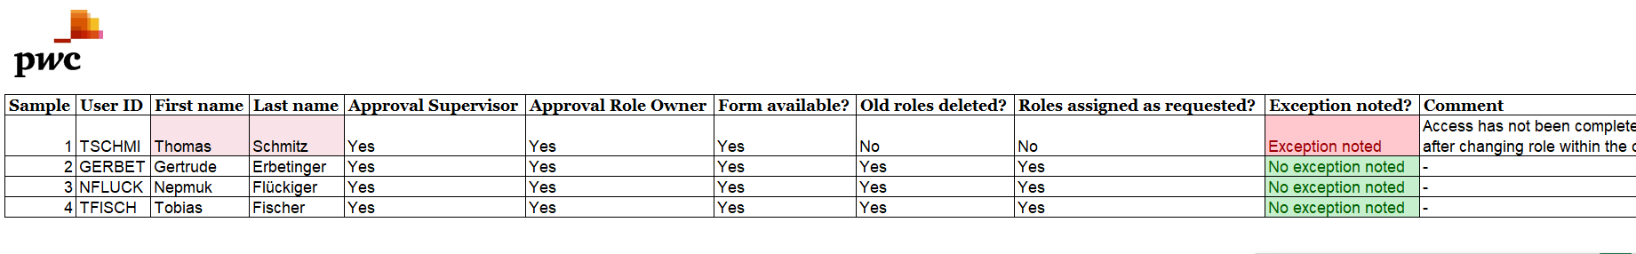
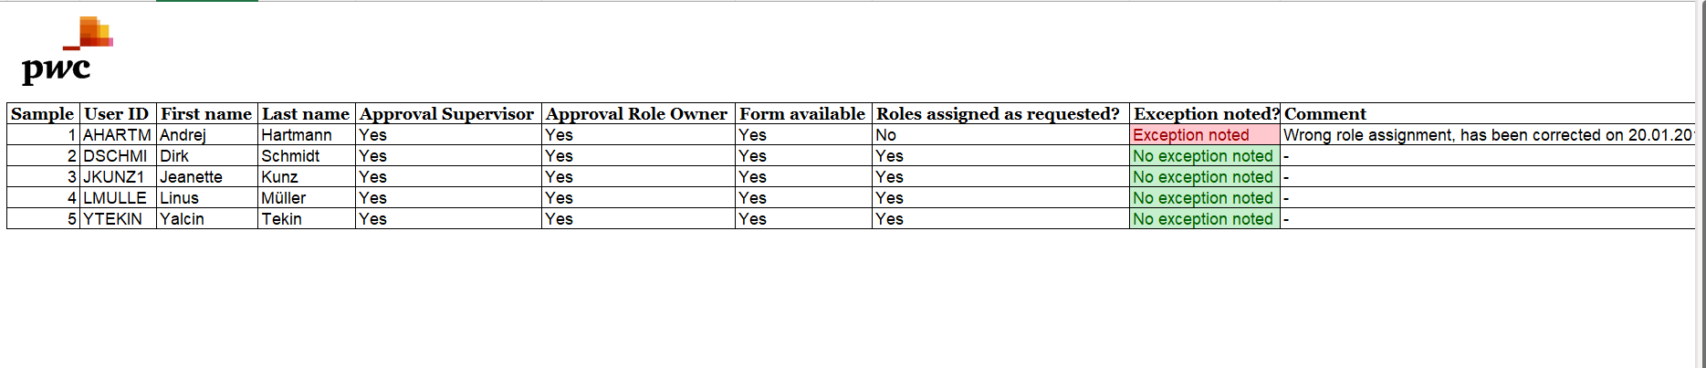
Audit filled of pwc

Slide 7
Risk Assessment
Overall Risk Rating: Medium
Reason:
Incorrect role assignment detected
Potential risk of excessive access privileges
Password configuration compliant with policy
User deactivation controls functioning correctly

Slide 8
Recommendations
Implement stronger role assignment review process.
Introduce automated approval workflow for role changes.
Monitor repetitive claim payment values.
Periodically review user access privileges.
Continue monitoring IT general controls.

